Slide 1
AIDI 1010 – Introduction to Emerging Technologies WEEK12
Jahanzeb Abbas (JB)

Slide 2
Week Objectives
(A) AI vs AGI
(B) AGI – Are we close? Tech Adaption
(C) AGI – Black Box
(E) AGI – Developments
(E) AGI – Future steps
(F) References

Slide 3
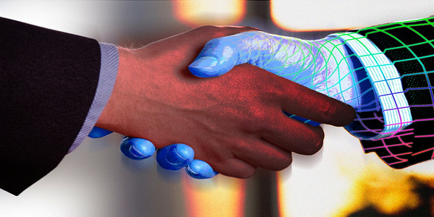
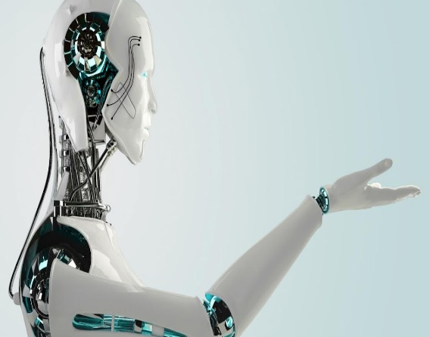
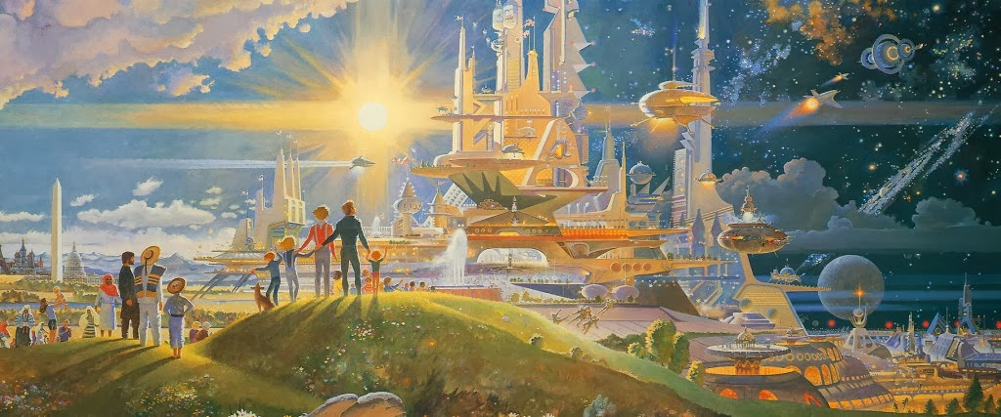
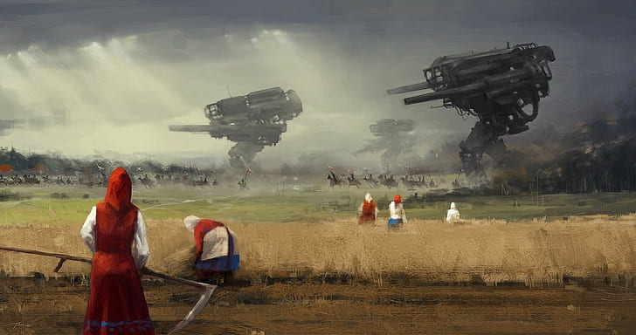
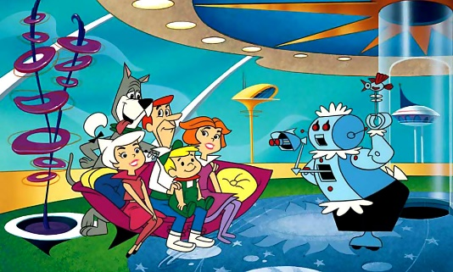
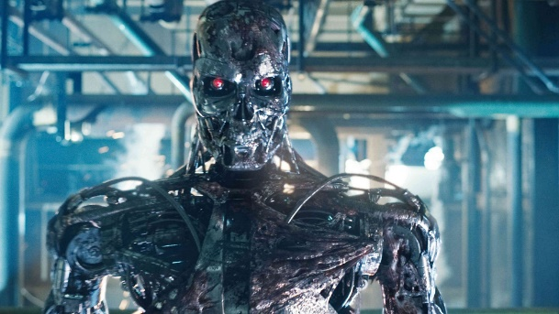
Artificial General Intelligence (AGI)

Slide 4
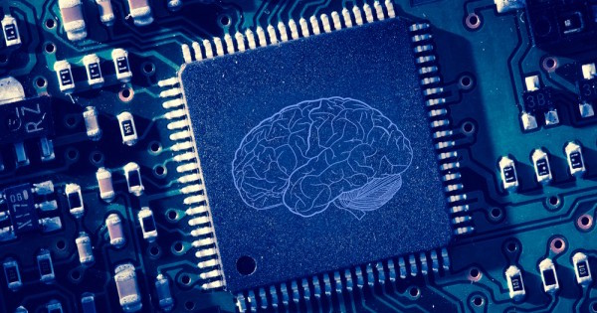
(A) AI vs AGI
Artificial Intelligence – [Wikipedia]
Artificial intelligence (AI) is intelligence demonstrated by machines, as opposed to the natural intelligence displayed by humans or animals. The study of "intelligent agents": any system that perceives its environment and takes actions that maximize its chance of achieving its goals. Machines that mimic "cognitive" functions that humans associate with the human mind, such as "learning" and "problem solving".

Slide 5
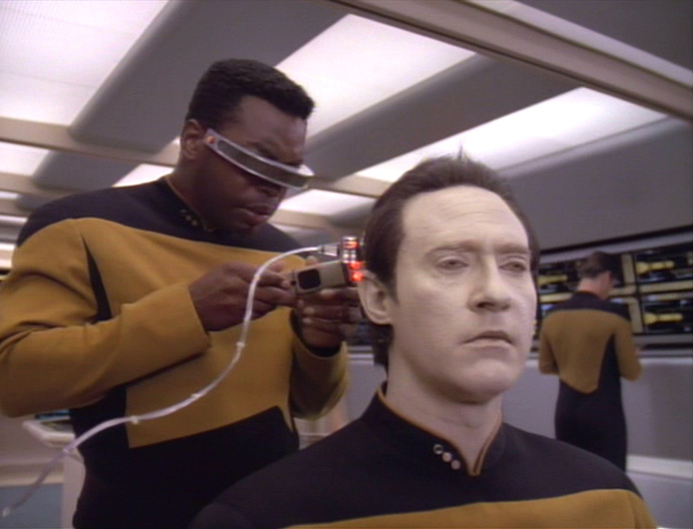
(A) AI vs AGI
Artificial “General” Intelligence – [Wikipedia]
Artificial general intelligence (AGI) is the hypothetical ability of an intelligent agent to understand or learn any intellectual task that a human being can. It is a primary goal of some artificial intelligence research and a common topic in science fiction and futures studies.
AGI can also be referred to as strong AI, full AI, or general intelligent action.
Some academic sources reserve the term "strong AI" for computer programs that can experience sentience, self-awareness and consciousness.
As of late 2010s, AI is speculated to be decades away from AGI.
aka.. Human Level A.I (long way to go)

Slide 6
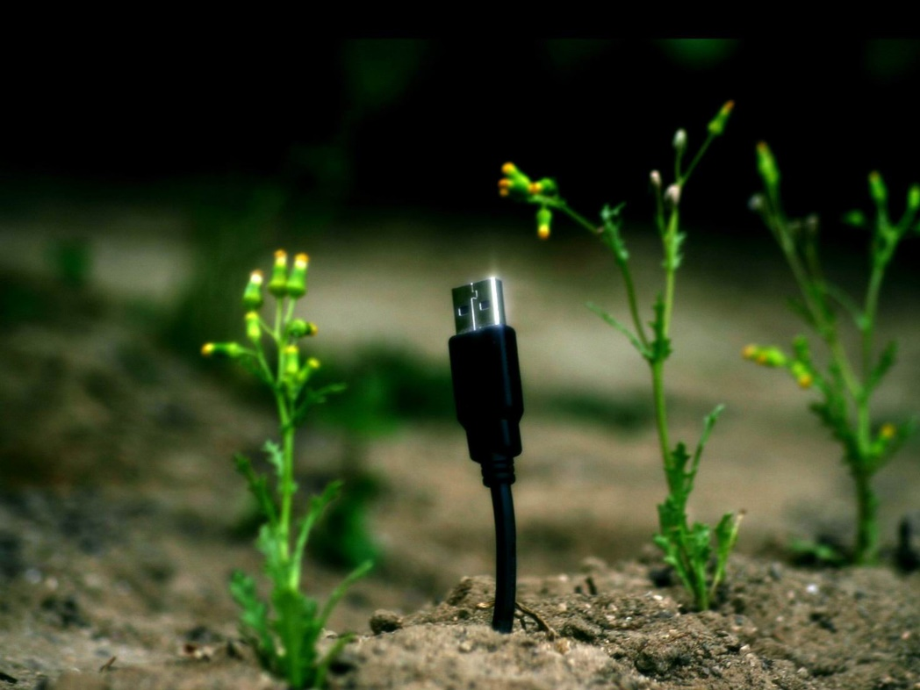

???
Are we already on the path towards it?
How will we get there?
How long till we get there?

Slide 7
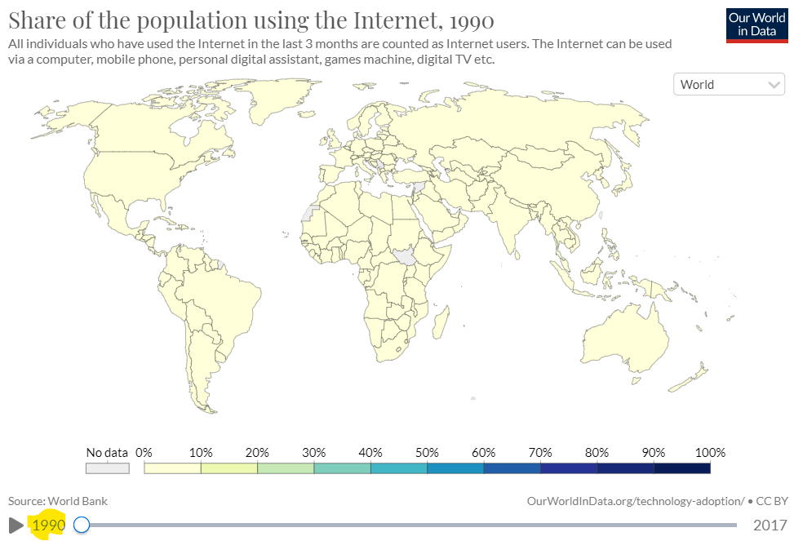
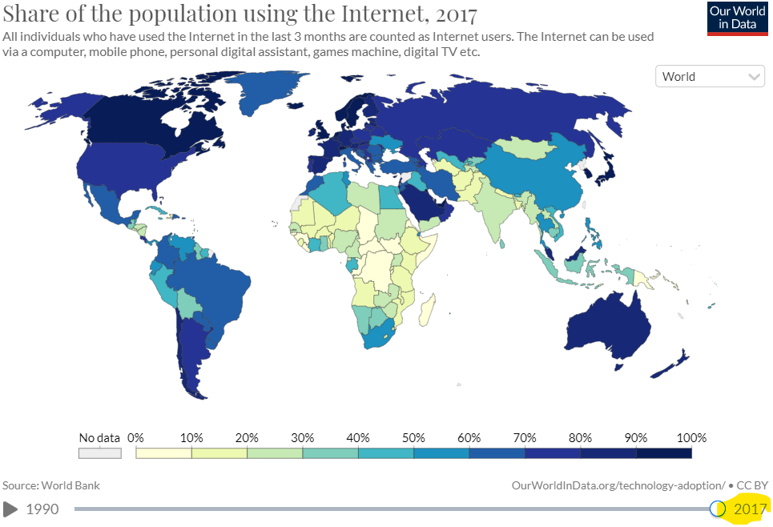
(B) AGI – Are we close? Tech Adaptation
https://ourworldindata.org/technology-adoption

Slide 8
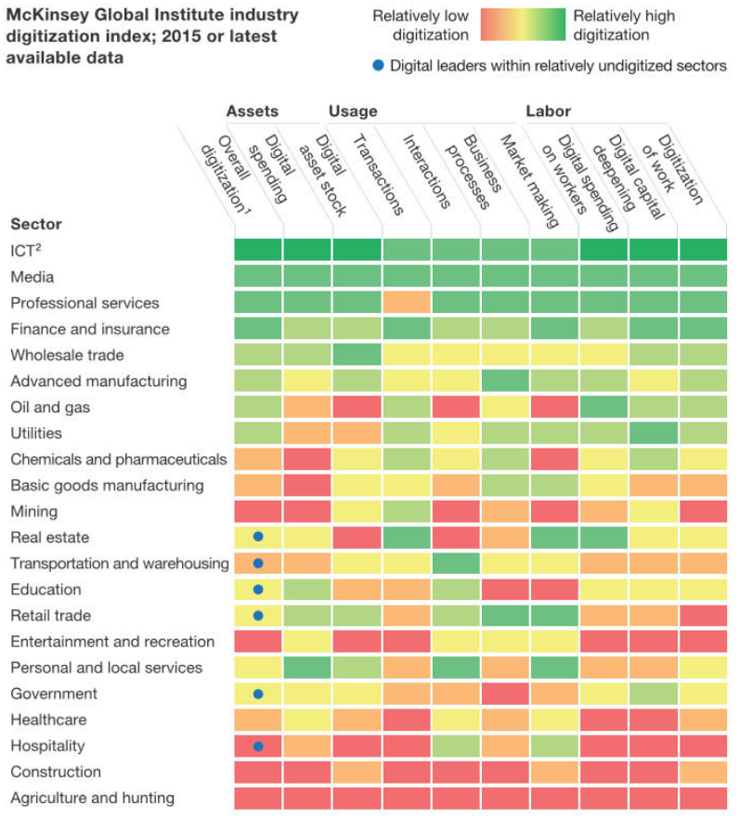
(B) AGI – Are we close? Tech Adaptation
Global industry digitisation index, McKinsey Global Institute

Slide 9
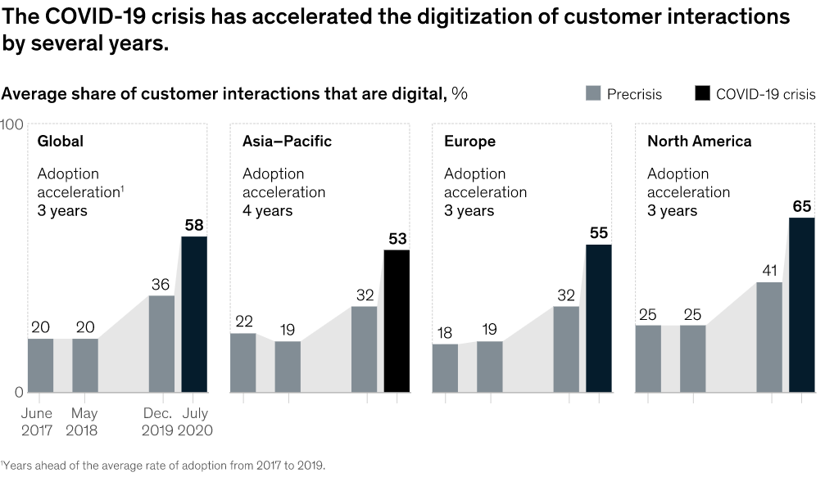
(B) AGI – Are we close? Tech Adaptation
McKinsey Global Institute

Slide 10
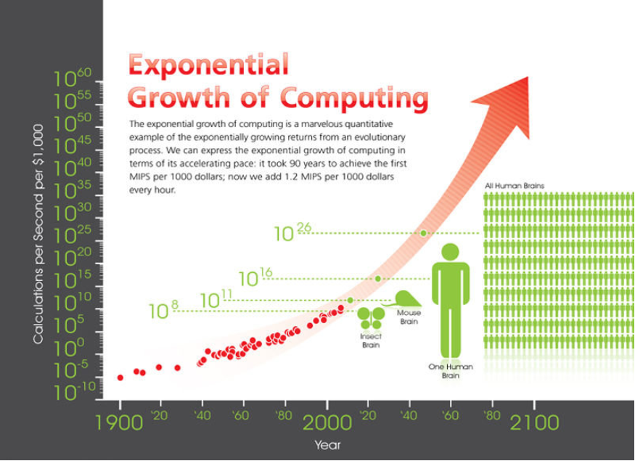
(B) AGI – Are we close? Tech Adaptation
Exponential growth of computing, Ray Kurzwel and KurzwelAI.net (red indicator J. Davies)

Slide 11
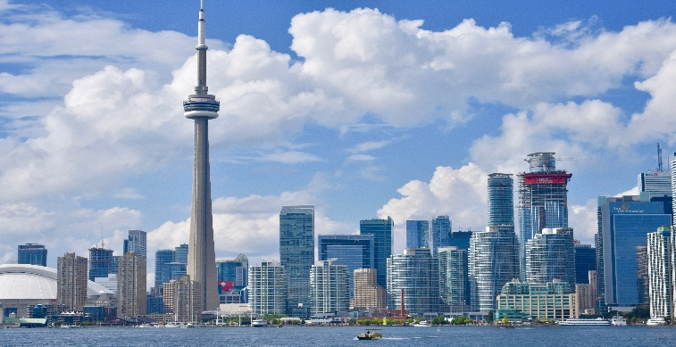

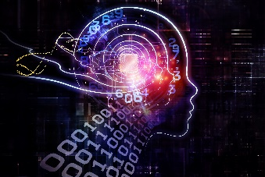
(C) AGI – Black Box
No impact
Utopia
Dystopia

Slide 12
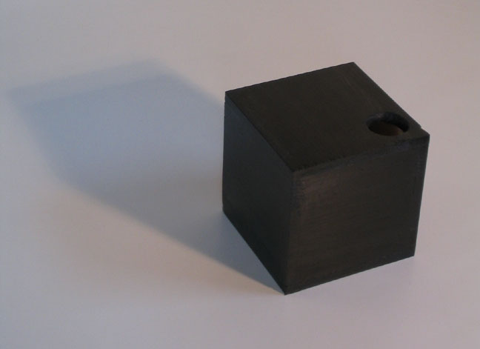
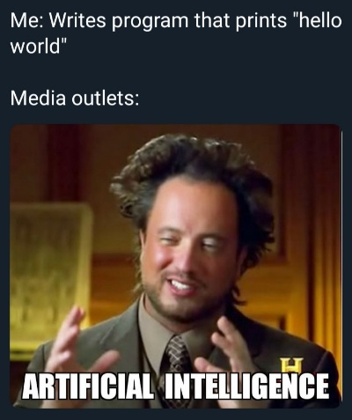
(C) AGI – Black Box
Hard Questions on AGI
What are the limitations and possibilities of achieve AGI?
What would be the safety, ethics, and any other fundamentals
What kind of methods do we have today, and their limitations?
Can we build intuition about this without knowing how to build it?
What are the future impacts of AGI? Disagreements of building new technologies?
How hard is it to build AGI? How far away are we from creating intelligent systems?
Pitfalls of Black Box Thinking, results in hype (detached from reality)
How fast is computation growing before we can potentially reach AGI?
How fast is technology being adopted by humans?
Neural Networks, Deep Learning, AutoML, Computational Neuroscience, Quantum Computing; Jobs Lost, Gained, Created due to AGI, diseases cured
Desire to explore.. uncovering the mysteries of the universe..

Slide 13
(C) AGI – Black Box
Experts are building insights and intuitions that can approach human level intelligence
MIT thinks we are very far away from creating anything that would resemble human level intelligence
Far – doesn’t equate to time
As of current ideas, approaches, guesses – our best understanding are not at the level of reaching full AGI without a major breakthrough in technology

Slide 14





(D) AGI - Developments
More general purpose algorithms are being created
AI Generating Algorithms (AI-GA)
MuZero, from Google’s DeepMind, can demonstrate planning/focus, determines what best course of action should be against any task; Chess, GO, Atari Video Games, with no prior knowledge of the games
Dall-E, from Open A.I, generate images based on text-prompts. If you ask a cloud made of zebras, it can generate images. It can generate any image you can think of.
AlphaFold v2, from Open A.I, Protein-folding in Biology, predictions are made on how 3D structures of a protein will result in a 2D sequence of amino acid; very complex configurations of proteins; helped with prediction of Coronavirus structures as accurately as laboratory methods
GPT-3 (Generative Pre-trained Transformer 3), from Open A.I, can create text when requested with different scenarios; it can answer questions with word prompts “Translate”, “Write Poems”. Anything with language, GPT-2 was nowhere near as capable.

Slide 15
(D) AGI - Developments
DeepMind and Open A.I are advancing the field of AGI
Open A.I, since 2015 – wants to develop positive AI and help humanity, and to make AI as widely accessible as possible
DeepMind, since 2010 – has already deployed real AI programs as per above
Microsoft, Facebook, and NVIDIA are also investing into AGI through cloud technologies

Slide 16
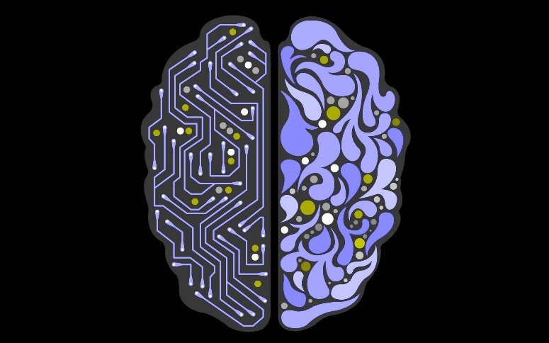
(E) AGI - Future steps
Understanding building blocks to AGI and how to combine the building blocks into a complex, thinking, machine
Understanding ethics & values within AGI Tech
Robots adapting like animals
Machines defeating humans in tasks (like games or competitions)
Understand machine learning trends: automation of machine learning or meta-learning (cross training or overtime learners) via learning agents
Meta-learning architectures, learning algorithms, and automatically generating effective learning environments; endlessly generating learning environments and solutions
AGI is predicted to be achieved 50% in 45 years; 10% in 12 years

Slide 17

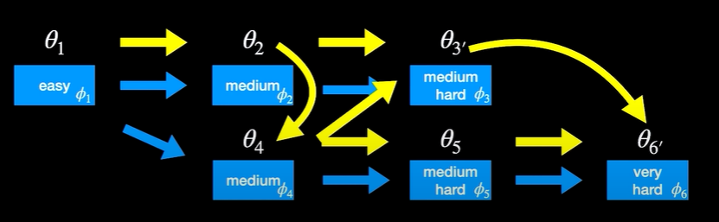
(E) AGI - Future steps
Traditional ML algorithms (pick a challenge -> solve it)
Open-ended algorithms, like natural evolution or human culture; i.e: can algorithms generate their own challenges and solve them? Example: Tree leaves -> Solution: Giraffes or Caterpillars
POET (Paired Open-Ended Trailblazer); Jeff Clune & Kenneth O. Stanley
Population-based search in machine learning
aims to periodically generate new learning environments
aims to allow goal switching
Generate Problems and constantly switch goals between solutions
Try to solve Task A, and if you make progress on task B, start optimizing task B
https://youtu.be/oZFbNiWhoDc

Slide 18
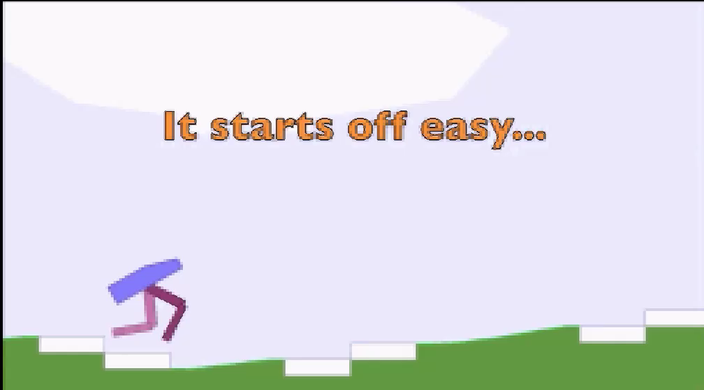
(E) AGI - Future steps
POET - Task: Obstacle Course
Run Fast; Don’t Fall; Reduce Torque; Balance Hull
4 motors; 10 LIDAR sensors; 14 other state variables
https://youtu.be/oZFbNiWhoDc

Slide 19
(F) AGI – Concluding Remarks
AGI might be closer than we think
Learn as much as possible about algorithms that will be designed to create challenges and come up with solutions themselves
Open-ended innovation engines are coming!
As long as we take care of the ethics and issues surrounding the usage of new-age AGI, we should be OK!
https://youtu.be/oZFbNiWhoDc

Slide 20
Disclaimer
Due to nature of the course, various materials have been compiled from different open source resources with some moderation.
The course designer (slides creator), sincerely acknowledges their hard work and contribution, credit will be given wherever necessary

Slide 21
References
https://youtu.be/-GV_A9Js2nM
https://en.wikipedia.org/wiki/Artificial_intelligence
https://en.wikipedia.org/wiki/Artificial_general_intelligence#Problems_requiring_AGI_to_solve
https://www.researchgate.net/figure/Exponential-growth-of-computing-Ray-Kurzwel-and-KurzwelAInet-red-indicator-J-Davies_fig2_325402968
https://www.researchgate.net/figure/Global-industry-digitisation-index-McKinsey-Global-Institute_fig3_325402968
https://www.mckinsey.com/business-functions/strategy-and-corporate-finance/our-insights/how-covid-19-has-pushed-companies-over-the-technology-tipping-point-and-transformed-business-forever
https://triare.net/insights/industries-digitalization-2021/
https://www.mckinsey.com/business-functions/strategy-and-corporate-finance/our-insights/how-covid-19-has-pushed-companies-over-the-technology-tipping-point-and-transformed-business-forever
https://ourworldindata.org/technology-adoption
https://youtu.be/Jciimt5mAaU
https://youtu.be/oZFbNiWhoDc
https://www.youtube.com/watch?v=g6HiuEnbwJE
https://medium.com/knowledge-engineering-seminar/paired-open-ended-trailblazer-poet-1a6ba7db543b

Slide 22

Thank You Very Much
Any Questions?

